Slide 1
Use of Portable Classrooms (PCs)
School Board Work Session
March 28th, 2013

Slide 2
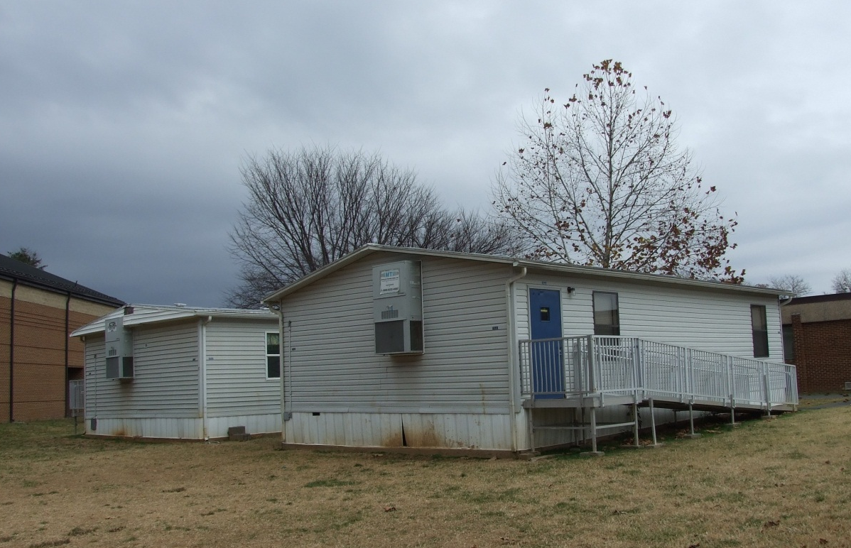
AGENDA
Portable Classrooms
How many do we have?
How are they used?
How many do we need?
Is there a plan to phase them out?
Case Studies
Discussion and Policy Statement

Slide 3
HOW MANY PCs DO WE HAVE?

Slide 4
Current count of PCs
Agnor-Hurt (3)
Broadus Wood (1)
Hollymead (5)
Jouett (1)
Meriwether Lewis (4)
Murray Elem. (1)
Murray High (4)
Red Hill (4)
Scottsville (4)
Stony Point (4)
Walton (1)
Western (4)
Woodbrook (3)
Yancey (2)
Child Nutrition (1)
DART (1)
43 Units Total

Slide 5
HOW ARE PCs USED?

Slide 6
Current use of PCs
Agnor-Hurt (3)
Broadus Wood (1)
Hollymead (5)
Jouett (1)
Meriwether Lewis (4)
Murray Elem. (1)
Murray High (4)
Red Hill (4)
Scottsville (4)
Stony Point (4)
Walton (1)
Western (4)
Woodbrook (3)
Yancey (2)
Child Nutrition (1)
DART (1)
KEY
Learning Spaces:
“Classroom”
Pull-Out
Other:
Office/Storage

Slide 7
Current use of PCs
Agnor-Hurt (3) | Music
Broadus Wood (1)
Hollymead (5)
Jouett (1)
Meriwether Lewis (4) | Music
Murray Elem. (1)
Murray High (4) | Enterprise | Enterprise | Enterprise | ISAEP
Red Hill (4) | Art/Gifted | Music
Scottsville (4) | Music | Art
Stony Point (4) | Classroom | Classroom
Walton (1)
Western (4) | Social Studies | English 9 & 10 | Algebra II | Creative Writing Algebra II/Trig.
Woodbrook (3)
Yancey (2) | Head Start
Child Nutrition (1)
DART (1)
KEY
Learning Spaces:
“Classroom” (17)

Slide 8
Current use of PCs
Agnor-Hurt (3) | Music | Gifted
Broadus Wood (1)
Hollymead (5)
Jouett (1)
Meriwether Lewis (4) | Music | Gifted | Special Ed | Special Ed
Murray Elem. (1) | ESOL/Speech/OT
Murray High (4) | Enterprise | Enterprise | Enterprise | ISAEP
Red Hill (4) | Art/Gifted | Music | Speech/ESOL | Storage/Small Group SPED
Scottsville (4) | Music | Art | Psychologist
Stony Point (4) | Classroom | Classroom | Gifted
Walton (1)
Western (4) | Social Studies | English 9 & 10 | Algebra II | Creative Writing Algebra II/Trig.
Woodbrook (3) | Family Support/ESOL | Coaches/ Psychologist
Yancey (2) | Head Start | Gifted & Math
Child Nutrition (1)
DART (1)
KEY
Learning Spaces:
“Classroom” (17)
Pull-Out (12)

Slide 9
Current use of PCs
Agnor-Hurt (3) | Music | Gifted | Region 10
Broadus Wood (1) | Storage
Hollymead (5) | Empty | Empty | Empty | Empty | Empty
Jouett (1) | PE Teacher/Weight Room/ Storage
Meriwether Lewis (4) | Music | Gifted | Special Ed | Special Ed
Murray Elem. (1) | ESOL/Speech/OT
Murray High (4) | Enterprise | Enterprise | Enterprise | ISAEP
Red Hill (4) | Art/Gifted | Music | Speech/ESOL | Storage/Small Group SPED
Scottsville (4) | Music | Art | Psychologist | Bright Stars Coor/Family Support
Stony Point (4) | Classroom | Classroom | Gifted | Inst. Coaches/ Family Support
Walton (1) | Storage
Western (4) | Social Studies | English 9 & 10 | Algebra II | Creative Writing Algebra II/Trig.
Woodbrook (3) | Family Support/ESOL | Coaches/ Psychologist | Region 10/ Support Center
Yancey (2) | Head Start | Gifted & Math
Child Nutrition (1) | Office
DART (1) | Office
KEY
Learning Spaces:
“Classroom” (17)
Pull-Out (12)
Other:
Office/Storage (9)

Slide 10
HOW MANY PCs ARE NEEDED?

Slide 11
Current need* of PCs: 2012/13 School year
Agnor-Hurt (3)
Broadus Wood (1)
Hollymead (5)
Jouett (1)
Meriwether Lewis (4)
Murray Elem. (1)
Murray High (4)
Red Hill (4)
Scottsville (4)
Stony Point (4)
Walton (1)
Western (4)
Woodbrook (3)
Yancey (2)
Child Nutrition (1)
DART (1)
43 Units Total

Slide 12
Current need* of PCs: 2012/13 School year
18/43
Units Total
Agnor-Hurt (3)
Broadus Wood (1)
Hollymead (5)
Jouett (1)
Meriwether Lewis (4)
Murray Elem. (1)
Murray High (4)
Red Hill (4)
Scottsville (4)
Stony Point (4)
Walton (1)
Western (4)
Woodbrook (3)
Yancey (2)
Child Nutrition (1)
DART (1)
Key
Needed
Not Needed
* “Need” is based on enrollment exceeding capacity calculation

Slide 13
future need* of PCs: 2017/18 School year
Agnor-Hurt (3) |  |  |  | +4
Broadus Wood (1)
Hollymead (5)
Jouett (1)
Meriwether Lewis (4)
Murray Elem. (1)
Murray High (4)
Red Hill (4)
Scottsville (4)
Stony Point (4) |  |  |  |  | +1
Walton (1)
Western (4)
Woodbrook (3)
Yancey (2)
Child Nutrition (1)
DART (1)
Key
Additional PC needed that is not on-site
Additional PC needed that is already on site
* “Need” is based on enrollment exceeding capacity calculation
** Additional schools are projected to be over capacity but do not have trailers currently: Brownsville, Crozet, Cale,& Albemarle

Slide 14
IS THERE A PLAN
TO REMOVE PCs?

Slide 15
Cip impact on ‘needed’ pcs
Murray High (4)
► | Summer 2013: Renovation will relocate students inside building and ARC to the PCs
Agnor-Hurt (3)
►
Red Hill (4)
►
Stony Point (4)
►
Yancey (2)
►
Scottsville (4)
►
Child Nutrition (1) |  | DART (1)
►
Meriwether Lewis (4)
►

Slide 16
Cip impact on ‘needed’ pcs
Murray High (4)
► | Summer 2013: Renovation will relocate students inside building and ARC to the PCs
Agnor-Hurt (3)
► | Addition to open for 2015/16 School Year (pending BOS approval) & remove all PCs
Red Hill (4)
►
Stony Point (4)
►
Yancey (2)
►
Scottsville (4)
►
Child Nutrition (1) |  | DART (1)
►
Meriwether Lewis (4)
►

Slide 17
Cip impact on ‘needed’ pcs
Murray High (4)
► | Summer 2013: Renovation will relocate students inside building and ARC to the PCs
Agnor-Hurt (3)
► | Addition to open for 2015/16 School Year (pending BOS approval) & remove all PCs
Red Hill (4)
► | Proposed Modernization project would remove all four PCs by 2017/18 School Year
Stony Point (4)
►
Yancey (2)
►
Scottsville (4)
►
Child Nutrition (1) |  | DART (1)
►
Meriwether Lewis (4)
►

Slide 18
Cip impact on ‘needed’ pcs
Murray High (4)
► | Summer 2013: Renovation will relocate students inside building and ARC to the PCs
Agnor-Hurt (3)
► | Addition to open for 2015/16 School Year (pending BOS approval) & remove all PCs
Red Hill (4)
► | Proposed Modernization project would remove all four PCs by 2017/18 School Year
Stony Point (4)
► | March 2012: SB voted against redistricting any students; Proposed addition to open for 2019/20 School Year & remove all PCs
Yancey (2)
►
Scottsville (4)
►
Child Nutrition (1) |  | DART (1)
►
Meriwether Lewis (4)
►

Slide 19
Cip impact on ‘needed’ pcs
Murray High (4)
► | Summer 2013: Renovation will relocate students inside building and ARC to the PCs
Agnor-Hurt (3)
► | Addition to open for 2015/16 School Year (pending BOS approval) & remove all PCs
Red Hill (4)
► | Proposed Modernization project would remove all four PCs by 2017/18 School Year
Stony Point (4)
► | March 2012: SB voted against redistricting any students; Proposed addition to open for 2019/20 School Year & remove all PCs
Yancey (2)
► | Proposed project would eliminate both PCs by 2019/20 School Year
Scottsville (4)
►
Child Nutrition (1) |  | DART (1)
►
Meriwether Lewis (4)
►

Slide 20
Cip impact on ‘needed’ pcs
Murray High (4)
► | Summer 2013: Renovation will relocate students inside building and ARC to the PCs
Agnor-Hurt (3)
► | Addition to open for 2015/16 School Year (pending BOS approval) & remove all PCs
Red Hill (4)
► | Proposed Modernization project would remove all four PCs by 2017/18 School Year
Stony Point (4)
► | March 2012: SB voted against redistricting any students; Proposed addition to open for 2019/20 School Year & remove all PCs
Yancey (2)
► | Proposed project would eliminate both PCs by 2019/20 School Year
Scottsville (4)
► | Proposed Addition to open for 2020/21 School Year and remove all PCs
Child Nutrition (1) |  | DART (1)
►
Meriwether Lewis (4)
►

Slide 21
Cip impact on ‘needed’ pcs
Murray High (4)
► | Summer 2013: Renovation will relocate students inside building and ARC to the PCs
Agnor-Hurt (3)
► | Addition to open for 2015/16 School Year (pending BOS approval) & remove all PCs
Red Hill (4)
► | Proposed Modernization project would remove all four PCs by 2017/18 School Year
Stony Point (4)
► | March 2012: SB voted against redistricting any students; Proposed addition to open for 2019/20 School Year & remove all PCs
Yancey (2)
► | Proposed project would eliminate both PCs by 2019/20 School Year
Scottsville (4)
► | Proposed Addition to open for 2020/21 School Year and remove all PCs
Child Nutrition (1) |  | DART (1)
► | Proposed Support Services Building to open for 2022/23 School Year & remove both PCs
Meriwether Lewis (4)
►

Slide 22
Cip impact on ‘needed’ pcs
Murray High (4)
► | Summer 2013: Renovation will relocate students inside building and ARC to the PCs
Agnor-Hurt (3)
► | Addition to open for 2015/16 School Year (pending BOS approval) & remove all PCs
Red Hill (4)
► | Proposed Modernization project would remove all four PCs by 2017/18 School Year
Stony Point (4)
► | March 2012: SB voted against redistricting any students; Proposed addition to open for 2019/20 School Year & remove all PCs
Yancey (2)
► | Proposed project would eliminate both PCs by 2019/20 School Year
Scottsville (4)
► | Proposed Addition to open for 2020/21 School Year and remove all PCs
Child Nutrition (1) |  | DART (1)
► | Proposed Support Services Building to open for 2022/23 School Year & remove both PCs
Meriwether Lewis (4)
► | March 2013: SB voted against redistricting any students Proposed Crozet addition MAY impact these PCs

Slide 23
Plan for remaining pcs
Broadus Wood (1)
Hollymead (5)
Jouett (1)
Murray Elem. (1)
Walton (1)
Western (4)
Woodbrook (3)
There is currently no plan to remove these 16 units until a need is deemed necessary at another location.
Estimate cost to relocate: $20,000
Other options: move to central storage or salvage/sell

Slide 24
CASE STUDIES

Slide 25
PC CASE STUDY #1
Stony Point Elementary
4 Trailers:
2 are used as Fifth Grade Classrooms
1 is used for Gifted Resource
1 is used for Instructional Coaches & Family Resources
Three units were added in 2000/01 & the fourth was added in 2009/10.
The school’s building capacity is 225. They are currently 62 students over capacity and are projected to be 96 students over capacity in 5 years.
In March 2012, the School Board voted against redistricting students to Stone Robinson Elementary.

Slide 26
PC CASE STUDY #2
Red Hill Elementary
4 Trailers:
Art/Gifted
Music
Speech/ESOL
Storage/Small Group SPED
One has been there since at least 1999. One was added in each of the following years: 2001/02, 2003/04 and 2007/08
The school’s building capacity is 160. They are currently 8 students over capacity and are projected to be 13 students over capacity in 5 years.

Slide 27
DISCUSSION

Slide 28
Discussion topics
Benefits
Provides additional space
Offers flexibility in how building is used
Inexpensive solution to create space
Offers temporary solution to allow time for redistricting or an addition
What else????
Difficulties
Security
Lack of restrooms and running water
Impact of weather on access
Inhibits collaboration amongst teachers & students
Energy costs (2x normal building)
Displacement of other land use
(i.e. playground space)
What else????
Proposed Policy
How should a new policy affect the decisions about the role of Portable Classrooms? Including:
  How PCs are used
  When PCs are introduced
  How long PCs are used

Slide 30
Policy FB: Facility planning
Policy FB: Facility Planning
Policy is organized by the roles of Superintendent, School Board & Advisory Committees in regards to school facilities.
Topics include:
  Building Capacity
  Redistricting
  Capital Improvement Program
  Long Range Planning Advisory Committee

